Slide 1

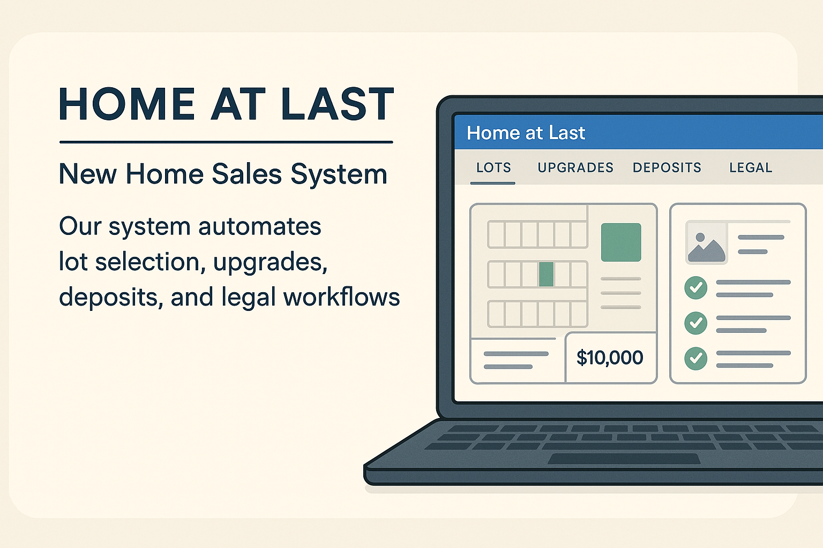
Home at Last – New Home Sales System

Slide 2
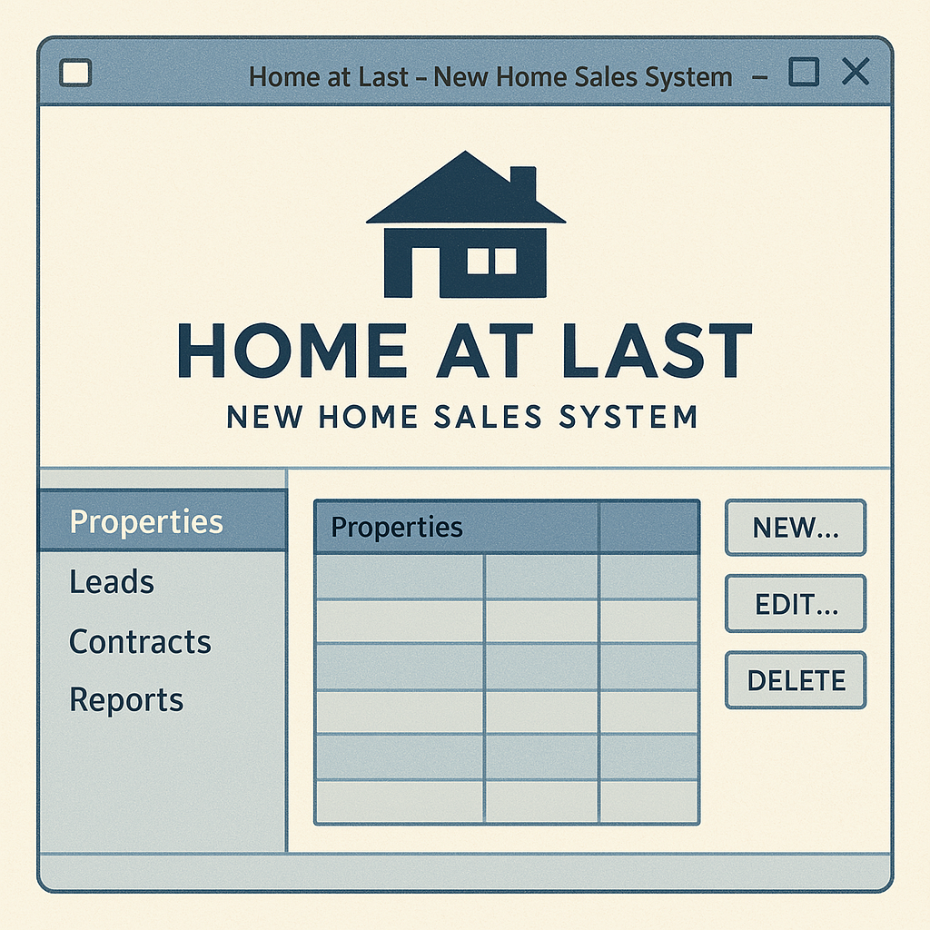

Agenda
Application: Home at Last Sales Automation System
Purpose: Automate lot selection, upgrades, agreements, and transactions
Group: GreatestGroupEver
Group members:
Wendell Destang
Adnan Haider
Quinton Goulbourne-Byard
Kamrul Hasan
Josh Hindle

Slide 3
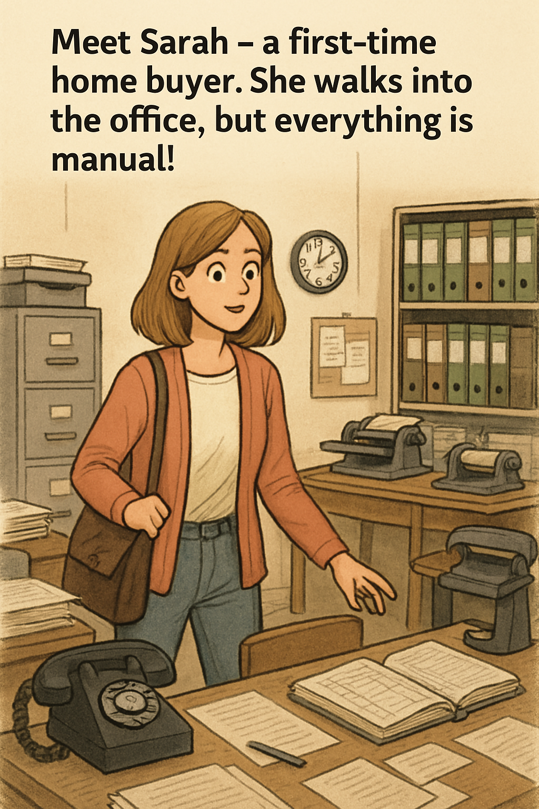
The Story
She has to fill out paper forms for her buyer profile, which delays the process
Sales agents shuffle through folders of printed layouts and price sheets just to help her find a suitable model and lot.
With the Home at Last Sales Automation System, we streamline lot selection, upgrade customization, deposit tracking, and legal documentation — all in one seamless workflow.
Home at Last gains efficiency, control, and faster turnaround.

Slide 4
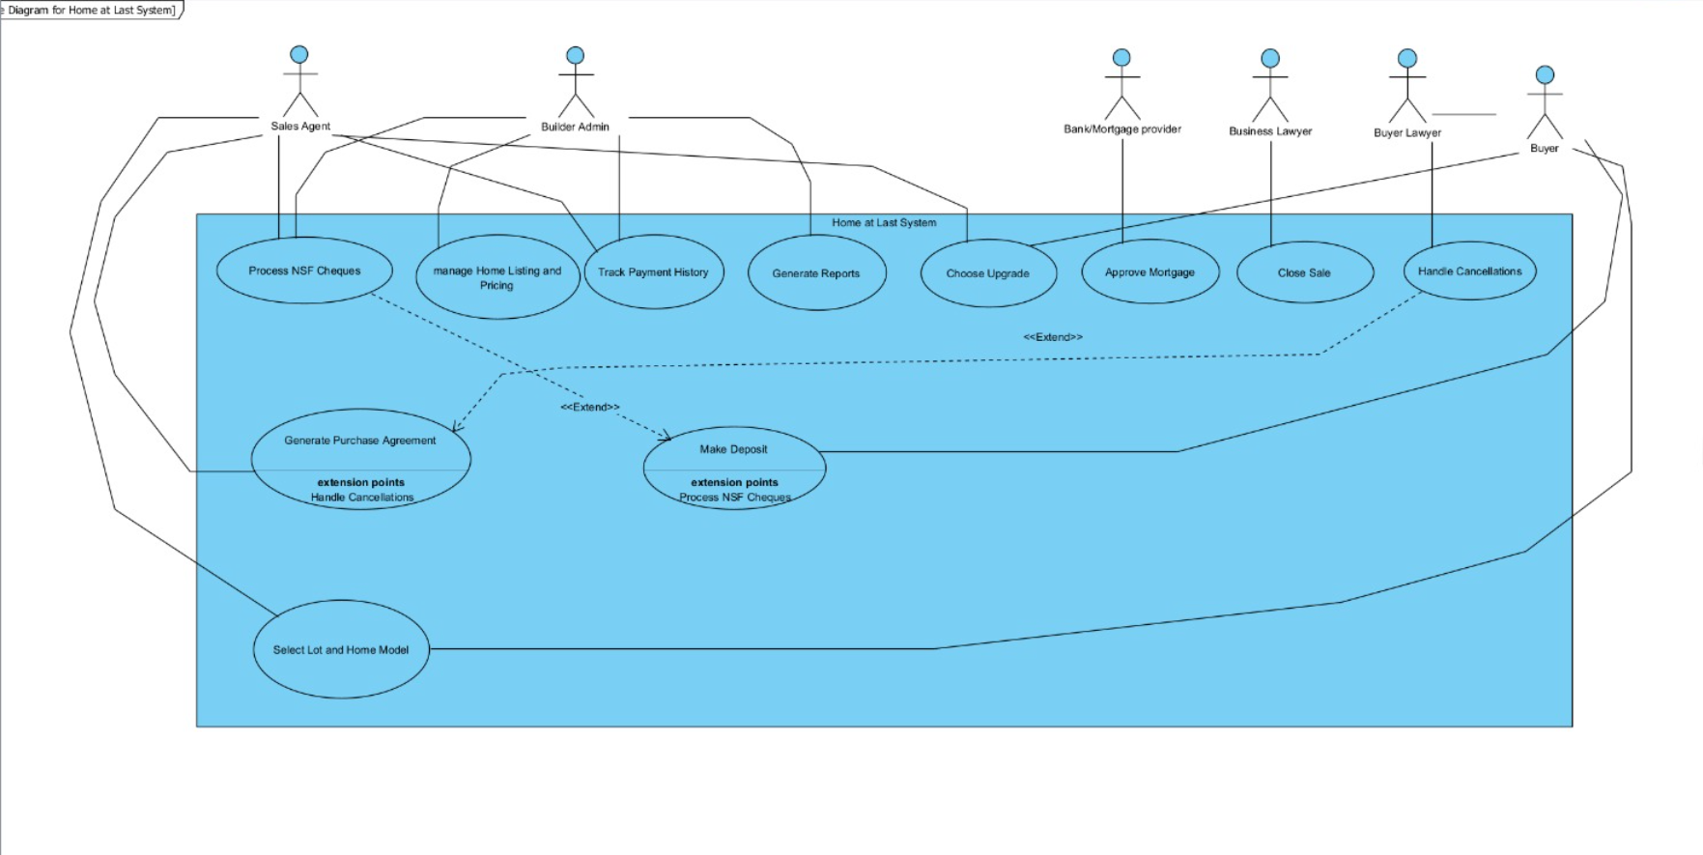

Use Case Overview
Our system revolves around 5 major use cases
1. Select Lot and Model
2. Generate Purchase Agreement
3. Make Deposits
4. Handle Cancellations
5. Close Sale

Slide 5
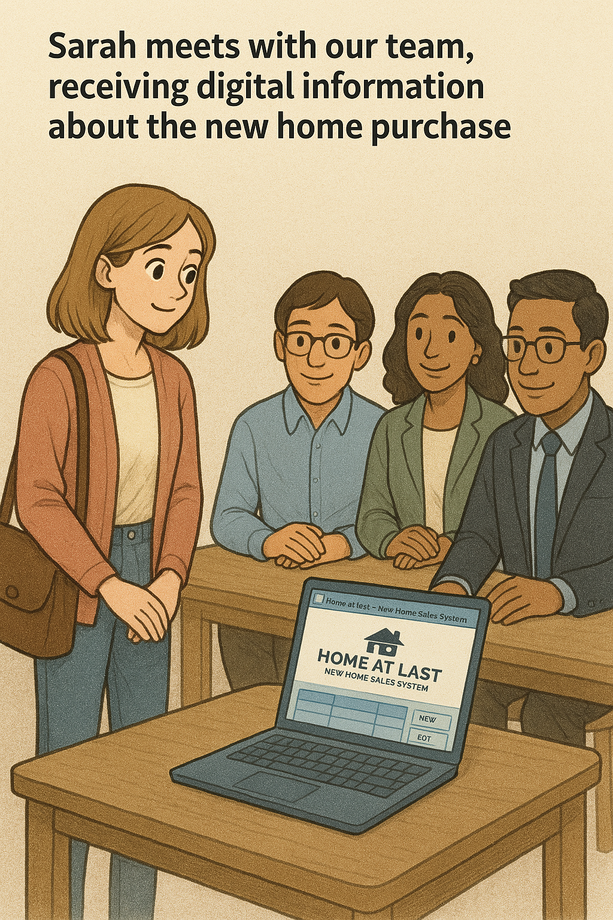
Use Case Narratives
Each use case reflects real-world steps.
Example 1
Example 2
Use Case Name: Generate Purchase Agreement
- Sales agent inputs data
- System calculates cost and generates agreement
Robust deposit tracking and buyer interactions
Use Case Name: Handle Cancellation
Buyer requests cancellation.
System checks 5-day cooling period.
System notifies Buyer’s Lawyer.
Lawyer reviews and completes docs.
System updates status and lot availability (refund if within 5 days).

Slide 6
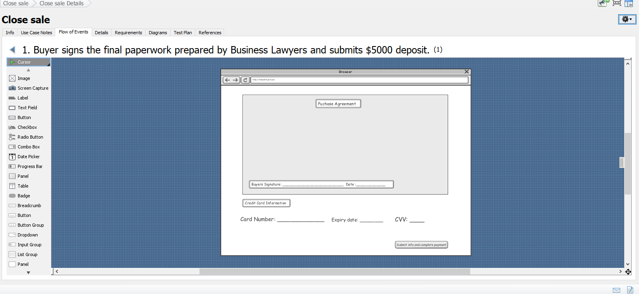

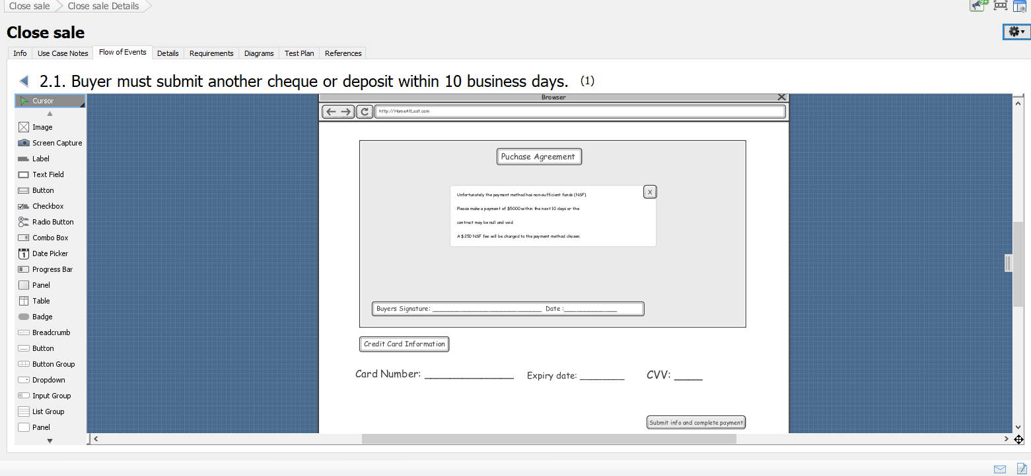
Storyboard
Visual flow shows screen-by-screen interaction
Example for “Close Sale” use case
Ensures ease of use and process transparency

Slide 7
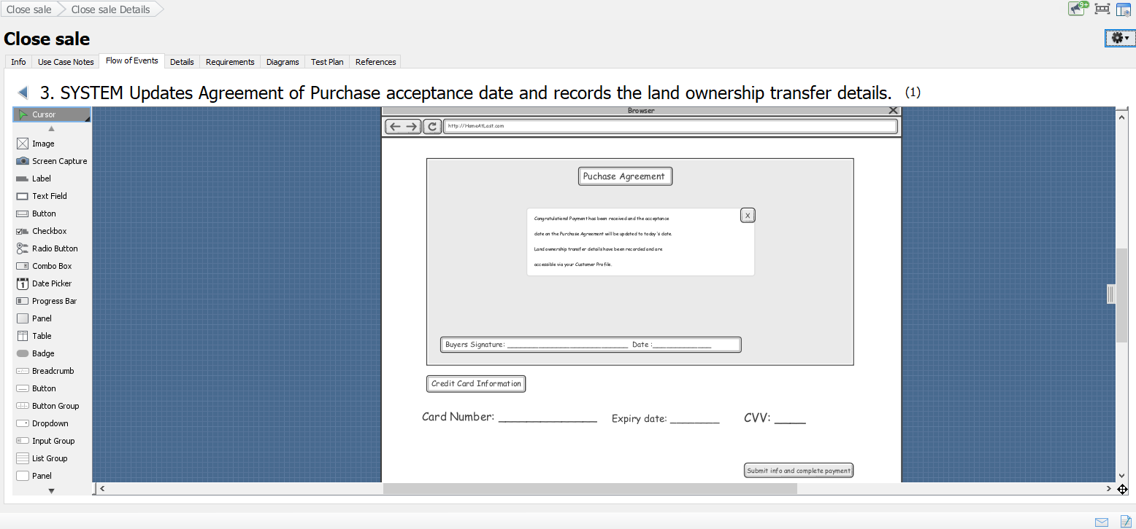
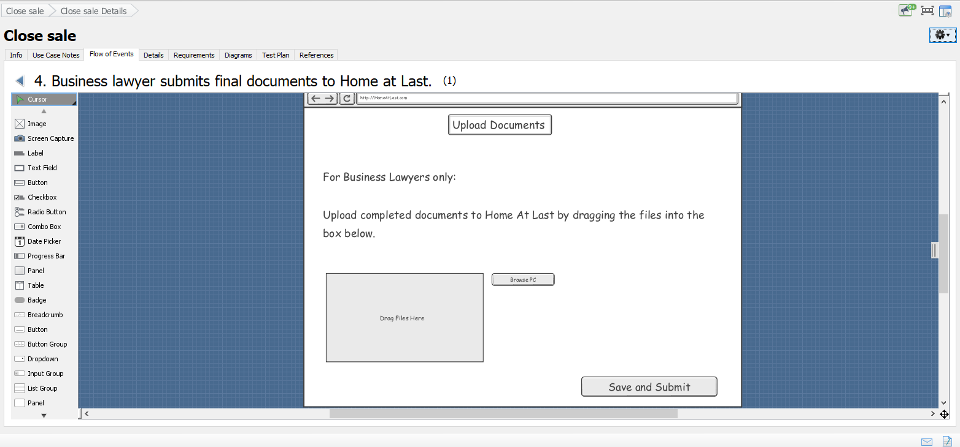
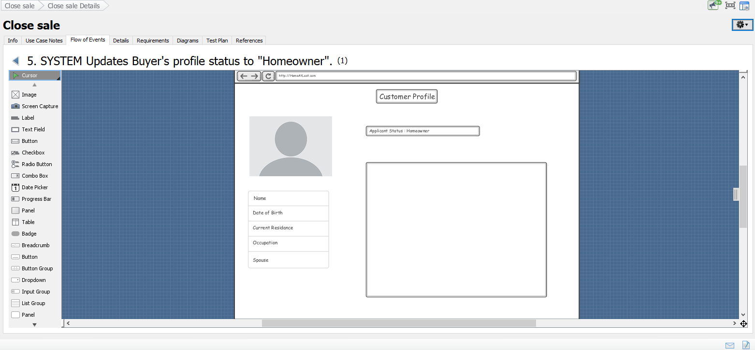
Storyboard

Slide 8
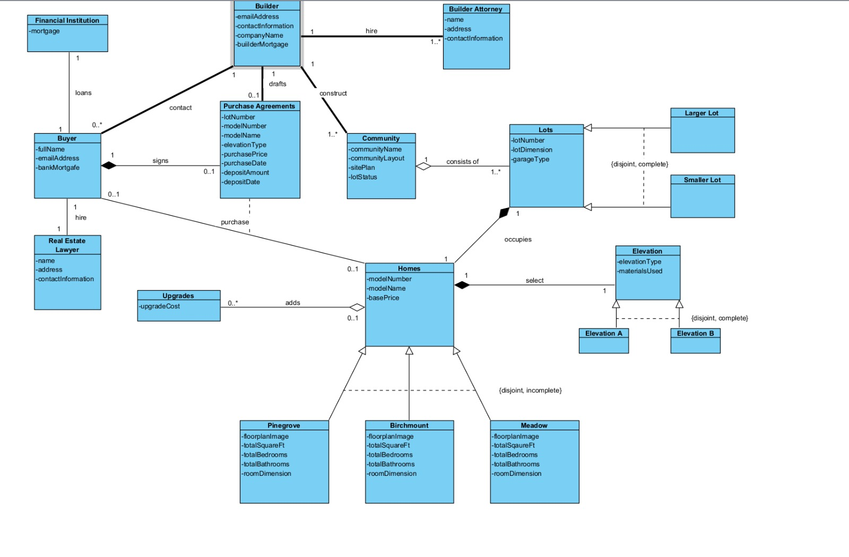
Domain/Class Diagram
Core classes: Buyer, Lot, ModelHome, Upgrade, Agreement, Lawyer
Relationships mirror business logic
Supports traceable, maintainable development

Slide 9
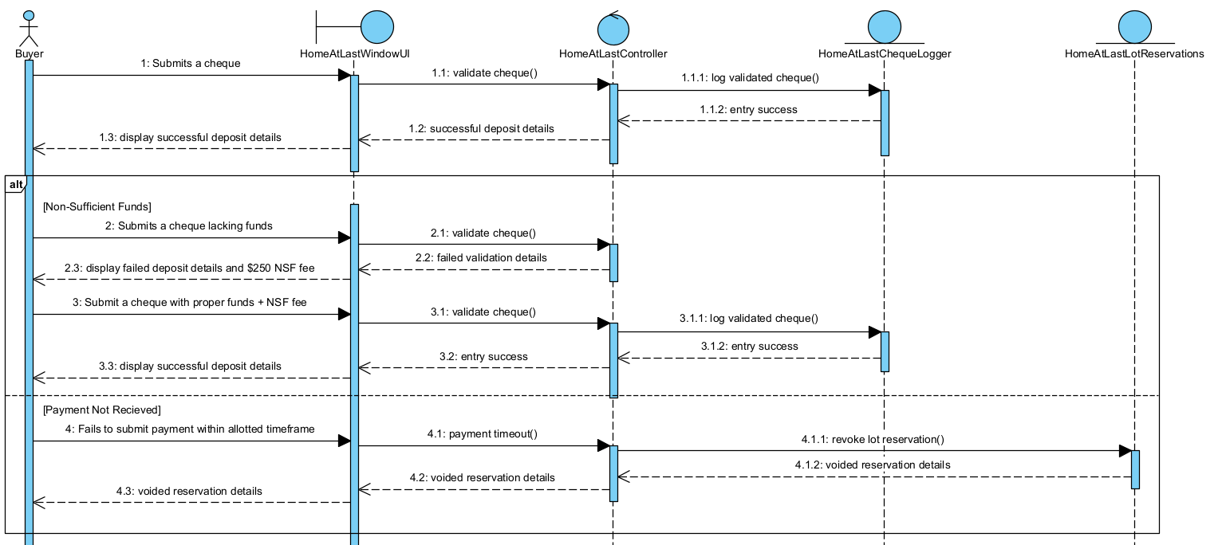



SEQUENCE DIAGRAM
At the core, we have entities like Buyer, Lot, ModelHome, Upgrade, Agreement, and Lawyer.
These classes have attributes that capture vital information, such as contact details, pricing, upgrade options, and status tracking.
Relationships are designed to reflect real-world constraints. For example, each Buyer is linked to an Agreement, which includes multiple Deposits, and a selected ModelHome with its Upgrades.
This object structure ensures all business logic and decision points are traceable, maintainable, and easy to build upon.

Slide 10
System Architecture
Structured into UI, Business Logic, and Data Layer
Scalable and adaptable design
Supports future web-based expansion
Home at Last is ready to evolve.
Let’s build the future of home sales together!
Thank you!
Questions?

